Slide 1
Community Service System
NAME | NUID
Dandan Xu | 001085732
Shijie Zhang | 001537250
Zhi Yao | 001520706

Slide 2

ABOUT ECOSYSTEM
The purpose of the Community Service System is to offer support to the individual and family in our community and provides great convenience for residents in daily life. Additionally, this application can manage each operational unit and attribute of the community’s organization.

Slide 3





PROBLEM STATEMENT
With the popularity of mobile phones, everyone is accustomed to completing daily tasks on cell phones, but there is no single application that can uniformly manage employees in the community and put forward service requirements for organizations in the community.
The system integrates the services of the community’s medical, education, property, and shopping, etc., so that residents no longer need to switch applications to meet their needs for different organizations, and at the same time facilitate community managers to manage the organization.

Slide 4
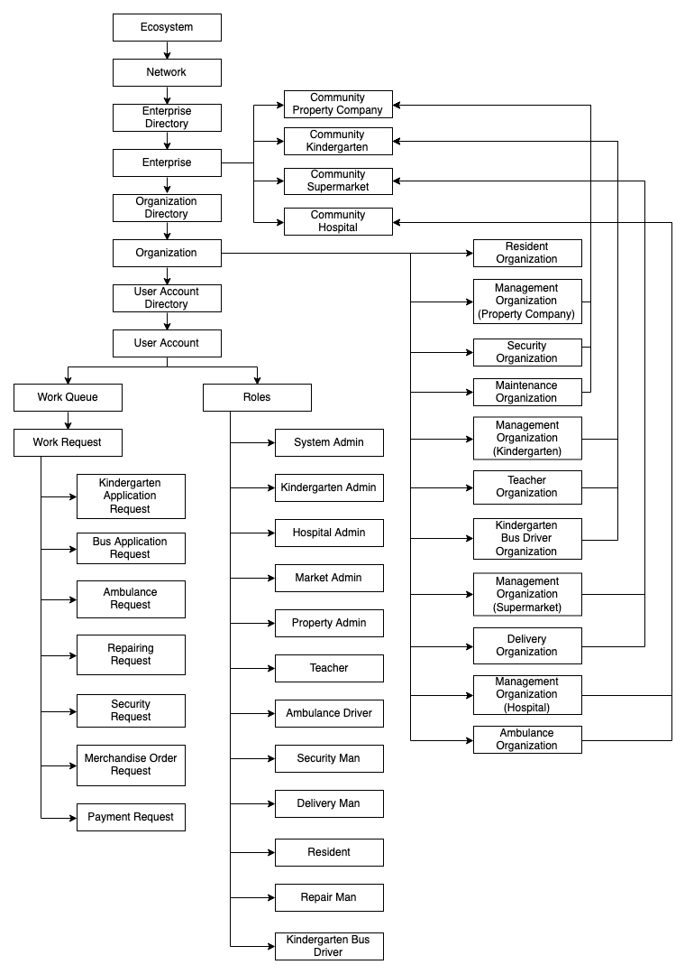
SYSTEM AED

Slide 5

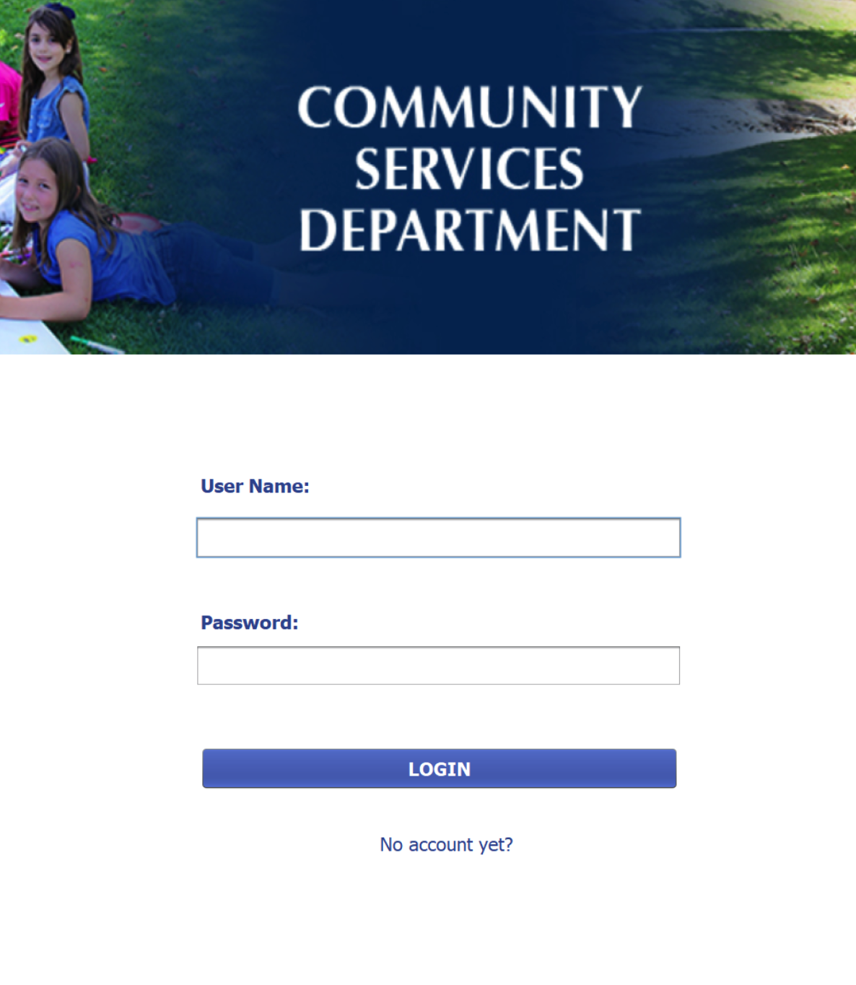
System Demo and Presentation

Slide 6

Thank you

